Slide 1
Bipolar Junction Transistor (BJT)
CHAPTER 2
Nishchal Acharya

Slide 2
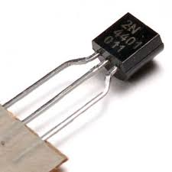
Introduction
The basic of electronic system nowadays is
semiconductor device.
The famous and commonly use of this device is BJTs
(Bipolar Junction Transistors).
It can be use as amplifier and logic switches.
TRANSISTOR = TRANSFER + VARISTOR
Two types of BJT : pnp and npn
Notes:
The word Transistor is an acronym, and is a combination of the words Transfer Varistor used to describe their mode of operation.
Transfer of a signal
Varistor means variable resistance.
Transistor made up of two pn junction
One is forward biased and the other is reverse biased. The forward bised junction has low resistance . While reverse biased junction has high resistance. The weak signal is introduced in the low resistance circuit and output is taken from high resistance circuit. Therefor a transistor transfers a signal from low resistance to high resistance
Transistors are three terminal active devices made from different semiconductor materials that can act as either an insulator or a conductor by the application of a small signal voltage. The transistor’s ability to change between these two states enables it to have two basic functions: “switching” (digital electronics) or “amplification” (analogue electronics). Then bipolar transistors have the ability to operate within three different regions:
Active Region – the transistor operates as an amplifier and Ic = β.Ib ---
Saturation – the transistor is “Fully-ON” operating as a switch and Ic = I(saturation)
Cut-off – the transistor is “Fully-OFF” operating as a switch and Ic = 0
‹#›

Slide 3
Mode of operation
Active Region – the transistor operates as an amplifier and Ic = β.Ib
Saturation – the transistor is “Fully-ON” operating as a switch and Ic = I(saturation)
Cut-off – the transistor is “Fully-OFF” operating as a switch and Ic = 0
Notes:
‹#›

Slide 4
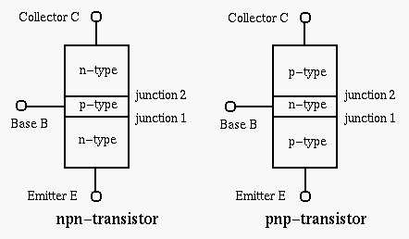
Transistor Construction
3 layer semiconductor device consisting:
2 n- and 1 p-type layers of material 🡪 npn transistor
2 p- and 1 n-type layers of material 🡪pnp transistor
The term bipolar reflects the fact that holes and electrons participate in the injection process into the oppositely polarized material
Notes:
If we now join together two individual signal diodes back-to-back, this will give us two PN-junctions connected together in series that share a common P or N terminal. The fusion of these two diodes produces a three layer, two junction, three terminal device forming the basis of a Bipolar Junction Transistor, or BJT for short.
In an NPN transistor, a thin and lightly doped P-type base is sandwiched between a heavily doped N-type emitter and another N-type collector; while in a PNP transistor, a thin and lightly doped N-type base is sandwiched between a heavily doped P-type emitter and another P-type collector
ALL BJT have
Two pn junction
Three terminals
The middle section is very thin .
‹#›

Slide 5
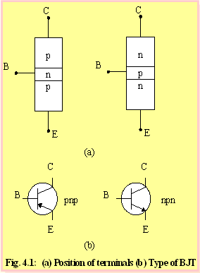
Naming the transistor terminals and symbol of BJT.
Base is located at the middle
and more thin from the level
of collector and emitter
The emitter and collector
terminals are made of the
same type of semiconductor
material, while the base of the
other type of material
Notes:
Has three sides. One side is emitter . And opposite to that is collector.middle section is called base and forms two junction between emitter and collector.
EMITTER
The section which supplies charge carriers (electrons or holes) is called emitter.
The emitter is always forward biased w.r.t. base
Pnp --- supplies holes
Npn --- supplies electrons
COLLECTOR
The section on other side that collects charge is called collector. The collector is always reverse biased w.r.t base. It recieves whatever is send through by emitter.
Pnp = recieves holes
Npn = recieves electrons
BASE
In between C and E
EB forward biased – so low resistance in emitter circuit --- fb applied is low
BC reverse biased – so high resistance in collector circuit—rb applied is high
The emitter is always heavily doped so that it can inject a large number of carriers .
The base is very thin and it passes most of the emitter injected charge carriers to the collector
The collector is moderately doped. The collector is wider than emitter and base, because during transistor operation much heat is produced at collector and thus made wider to dissipate heat.
‹#›

Slide 6
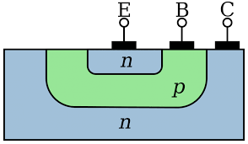
construction

Slide 7
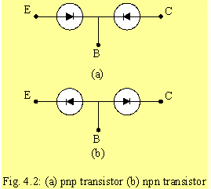
By imaging the analogy of diode, transistor can be
construct like two diodes that connetecd together.
It can be conclude that the work of transistor is base on
work of diode.

Slide 8
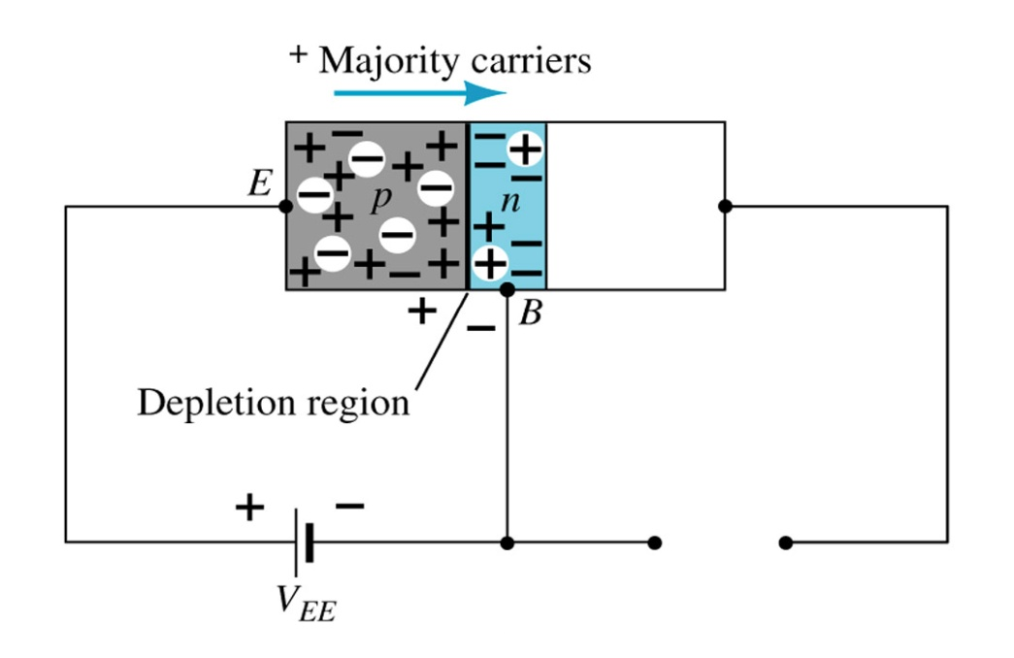
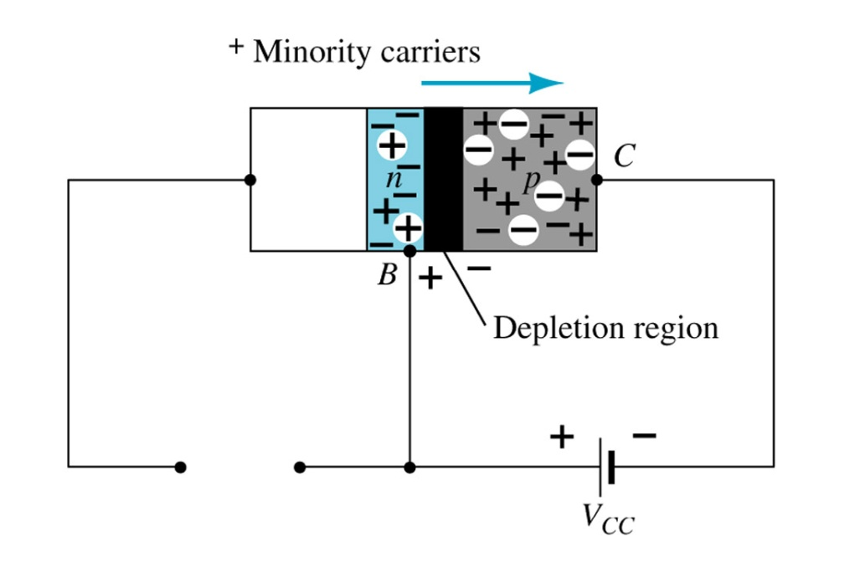
Transistor Operation
The basic operation will be described using the pnp transistor. The operation of the npn transistor is exactly the same if the roles played by the electron and hole are interchanged.
One p-n junction of a transistor is reverse-biased, whereas the other is forward-biased.
Forward-biased junction
of a pnp transistor
Reverse-biased junction
of a pnp transistor
Notes:
‹#›

Slide 9
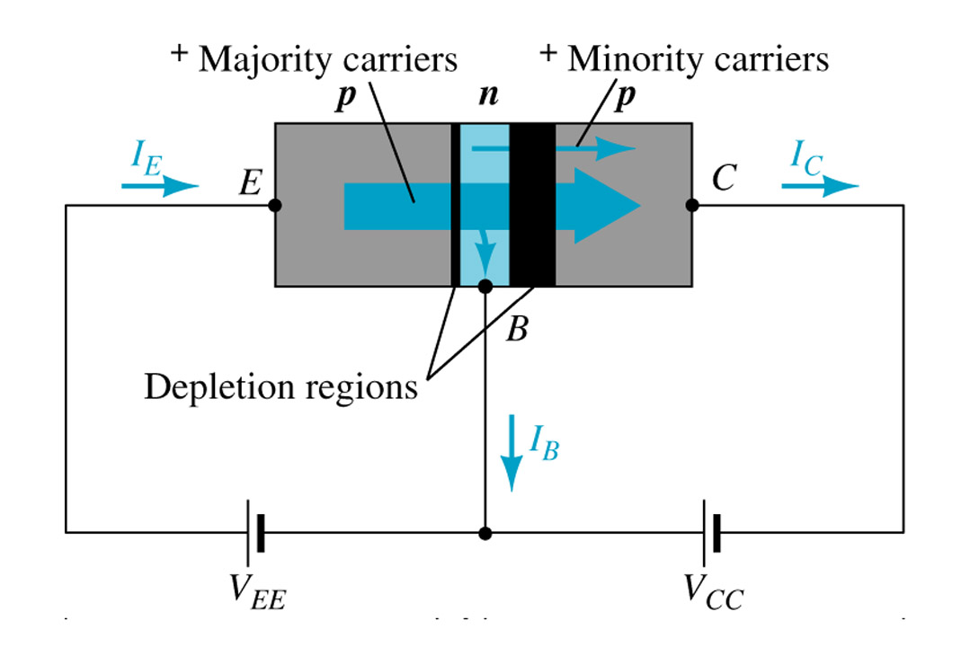
Both biasing potentials have been applied to a pnp transistor and resulting majority and minority carrier flows indicated.
Majority carriers (holes ) will diffuse across the forward-biased p-n junction into the n-type material.This constitutes emitter current I_{E.}
A very small number of carriers (holes) will combine with electrons in n-type material.
As the base is thin and lightly doped only few holes (5%)combine with electrons to constitute base current I_{B.}Resulting IB is typically in order of microamperes.
Notes:
Fb --- majority carriers pass through
Rb – minority carriers flow through
‹#›

Slide 10
The large number of majority carriers will diffuse across the reverse-biased junction into the p-type material connected to the collector terminal.
Majority carriers can cross the reverse-biased junction because the injected majority carriers will appear as minority carriers in the n-type material.
Applying KCL to the transistor :
I_{E} = I_{C} + I_{B}

Slide 11
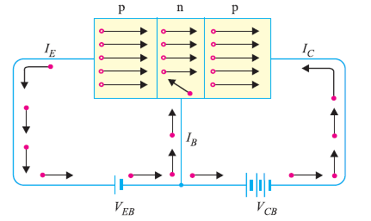
PNP operation
Notes:
Inside transistor current flows due to holes
Whereas in outer cicuit current flows due to electrons.
‹#›

Slide 12
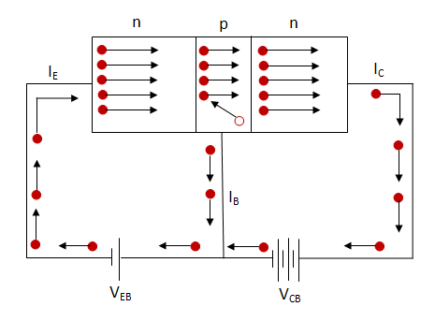
NPN Operation
Notes:
Inside transistor current flows due to electrons
Whereas in outer cicuit current flows due to electrons.
‹#›

Slide 13
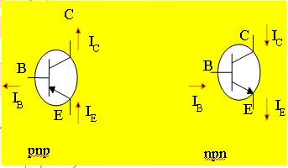
Transistor currents
The arrow is always drawn
on the emitter
The arrow always point
toward the n-type
The arrow indicates the
direction of the emitter
current:
pnp:E🡪 B
npn: B🡪 E
I_{C}=the collector current
I_{B}= the base current
I_{E}= the emitter current
Notes:
‹#›

Slide 14
Transistor configutation
There are only three terminals but while connecting transistor to a circuit it needs four terminals –two for input and two for output. Thus one terminal is made common to both input and output.
Depending on which of the three terminals is used as common terminal, there can be three possible configurations for a transistor:
Common emitter (CE),
Common base (CB),
Common collector (CC).

Slide 15
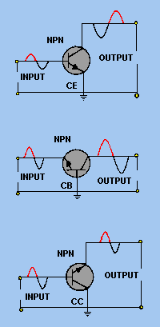

Slide 16
Common-Base Configuration
Common-base terminology is derived from the fact that the :
- base is common to both input and output of the configuration.
- base is usually the terminal closest to or at ground potential.
All current directions will refer to conventional (hole) flow and the arrows in all electronic symbols have a direction defined by this convention.
Note that the applied biasing (voltage sources) are such as to establish current in the direction indicated for each branch.
Notes:
There are only three terminals but while connecting transistor to a circuit it needs four terminals –two for input and two for output. Thus one terminal is made common to both input and output.
Depending on which of the three terminals is used as common terminal, there can be three possible configurations for the two-port network formed by a transistor:
Common emitter (CE),
Common base (CB),
Common collector (CC).
‹#›

Slide 17
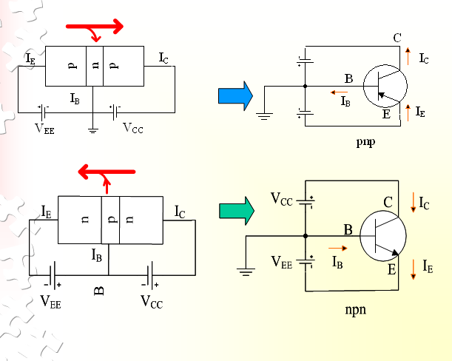
Notes:
Lets see how to make common base figure
First make transistor
Put arrow to show emitter
Make base commmon to both input and output
‹#›

Slide 18
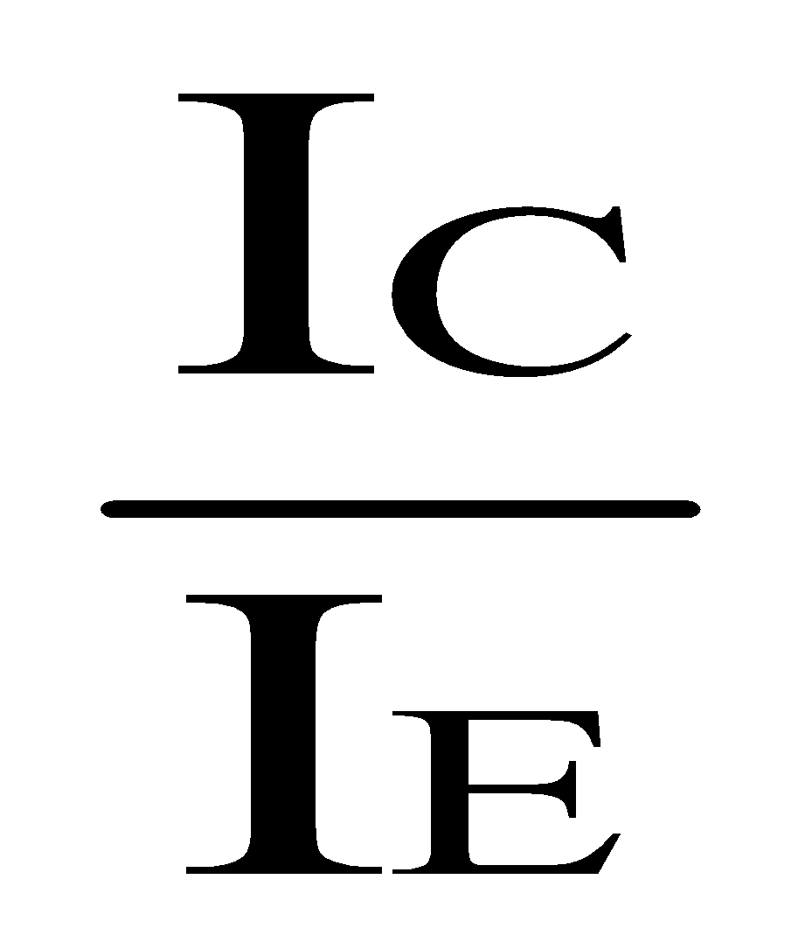
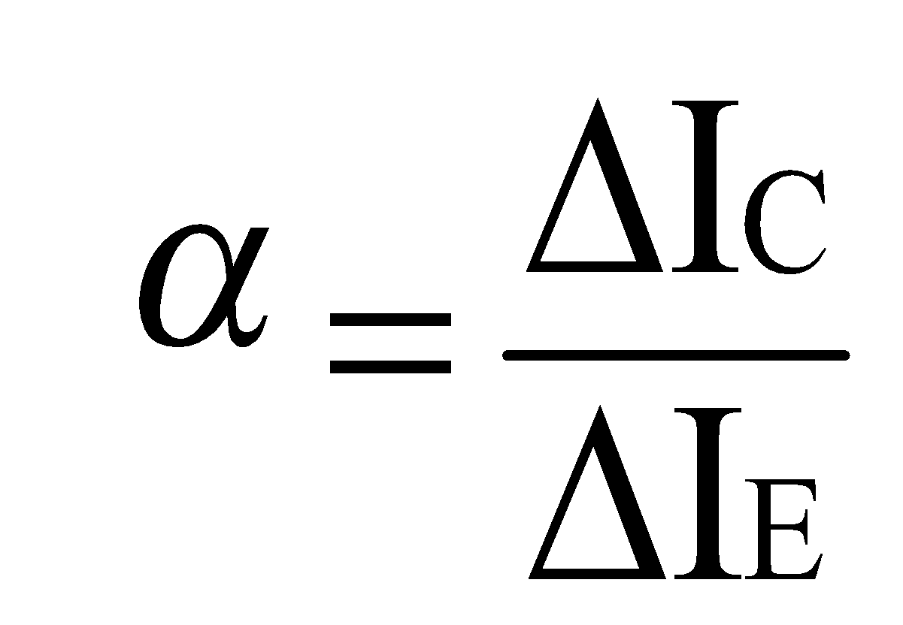
In the dc mode the level of I_{C} and I_{E} due to the majority carriers are related by a quantity called alpha(current amplification factor)
α=
I_{C} = αI_{E} + I_{CBO(leakage current)}
It can then be summarize to I_{C} = αI_{E} (ignore I_{CBO} due to small value)
For ac situations where the point of operation moves on the characteristics curve, an ac alpha defined by
Alpha a common base current gain factor that shows the efficiency by calculating the current percent from current flow from emitter to collector.The value of α is typical from 0.9 ~ 0.998.
Notes:
EXPRESSION FOR COLLLECTOR CURRENT .
Total collector current consist of
The part of emitter current that reaches collector --- αI_{E} alpha is less than 1..to increase alpha..base is made more thinner and less doping (as Ib reduces and increases Ic)
The leakage current I leakage . This current is due to movement of minority carriers across base – collector junction on account of it being reverse biased . This is much smaller than αI_{E.}
When I_{E} = 0 , only small leakage current flows in the collector circuit..which is called collector base current with emitter open I_{CBO}
‹#›

Slide 19
In short
Total collector current consist of
The part of emitter current that reaches collector --- αI_{E}
The leakage current I leakage . This current is due to movement of minority carriers across base – collector junction on account of it being reverse biased . This is much smaller than αI_{E.}
When I_{E} = 0 , only small leakage current flows in the collector circuit..which is called collector base current with emitter open I_{CBO}

Slide 20
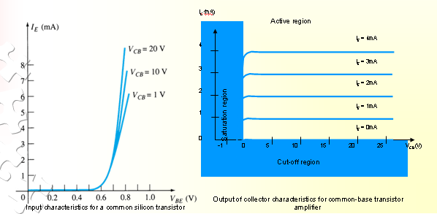
To describe the behavior of common-base amplifiers requires two set of characteristics:
Input or driving point characteristics.
Output or collector characteristics
Notes:
The complete electrical behaviour of a transistor can be described by stating the interrelation of the various currents and voltages. These relationships can be described graphically known as input output characterstics of a transistor
i/p o/p characterstics of a common base transistor is as follows :
Input characteristics
It is the curve between emitter current I_{E} and emitter base voltage Veb at constant collector base voltage Vcb.
The emitter currrent Ie increases rapidly with increase in emitter base voltage Veb which means input resistance is small
The emitter current is almost independent of collector base voltage Vcb.i.e. emitter current is independent of collector voltage
Output Characterstics
It is the curve between collector current Ic and collector base voltage Vcb at onstant emitter current Ie
Collector current varies with Vcb at very low voltages(less than 1V)..the transistor never operates in this region()
When value of Vcb reaches 1-2 V the collector current becomes constant (horizontal line in figure) and now is independent of collector base voltage Vcb. This is due to the fact that
collector current is only due to emitter current that passes base and flows into collector. The transistor always operates inthis region(active region)
3.Very high change in Vcb changes small amount of IC which means transistor has high output resistance
‹#›

Slide 21
Input characterstics
It is the curve between emitter(i/p) current I_{E} and emitter base (i/p)voltage Veb at constant collector base voltage Vcb.
The emitter currrent Ie increases rapidly with increase in emitter base voltage Veb which means input resistance is small
The emitter current is almost independent of collector base voltage Vcb.i.e. emitter current is independent of collector voltage
Notes:
As Vcb increses from 0V to 20 V , the Ie also increases , which is due to the reduction of the effective base width .
‹#›

Slide 22
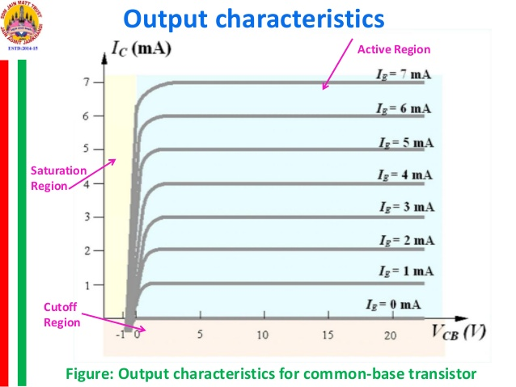
Output characteristics
Notes:
The output characteristics has 3 basic regions:
Active region –defined by the biasing arrangements
Cutoff region – region where the collector current is 0A
Saturation region- region of the characteristics to the left of V_{CB} = 0V
Active region: In this region the collector junction is reverse biased and the emitter junction is forward biased. In this region when IE= 0, IC = ICO. This reverse saturation current remains constant and is independent of collector voltage Vcb as long as is below the break down potential. When emitter current flows in the emitter circuit then a fraction (- IE) of this current reaches the collector. Hence IC = - IE + ICO. Thus in the active region the collector current is independent of collector voltage and depends only upon the emitter current. But due to Early effect there is a small increase (0.5%) in IC with increase in VCB
Saturation region: The region to the left of the ordinate VCB = 0 is called the saturation region. In this region both junctions are forward biased. This is also called as bottomed region because the voltage has a fallen near the bottom of the characteristic where VCB = 0. In this region IC increases rapidly with even small increase VCB in as shown in Fig
Cut-off region: The region below the IE= 0 characteristic, for which the emitter and collector junction are both reverse biased, is called cut-off region. This portion of characteristic is not coincident with the voltage axis as shown in Fig.
‹#›

Slide 23
Output characteristics
It is the curve between collector (o/p)current Ic and collector base(0/p) voltage Vcb at constant emitter current Ie
Collector current varies with Vcb at very low voltages(less than 1V)..the transistor never operates in this region()
When value of Vcb reaches 1-2 V the collector current becomes constant (horizontal line in figure) and now is independent of collector base voltage Vcb. This is due to the fact that collector current is only due to emitter current that passes base and flows into collector. The transistor always operates in this region(active region).
3.Very high change in Vcb changes small amount of IC which means transistor has high output resistance
Notes:
For a small negative voltage of Vcb both junction remain f.b and the region is called saturation region
‹#›

Slide 24
Output characateristics
Active region – emitter junction fb and collector junction reverse biased. Collector current depends only on emitter current
Saturation region: both junctions are forward biased. In this region IC increases rapidly with even small increase VCB(0-1 V)
. Cut-off region: both junction reverse biased, is called cut-off region.(Ie<=0)

Slide 25
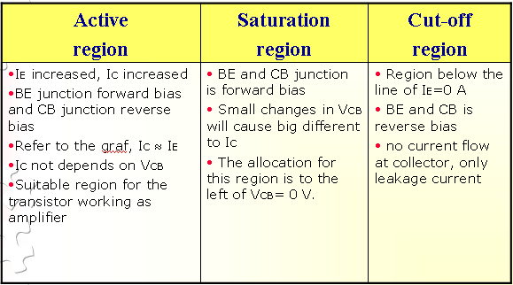

Slide 26
Common-Emitter Configuration
It is called common-emitter configuration since :
- emitter is common or reference to both input and output terminals.
- emitter is usually the terminal closest to or at ground
potential.
Almost amplifier design is using connection of CE due to the high gain for current and voltage.
Input is applied inbetween emitter and base and output is taken from collector and emitter.

Slide 27
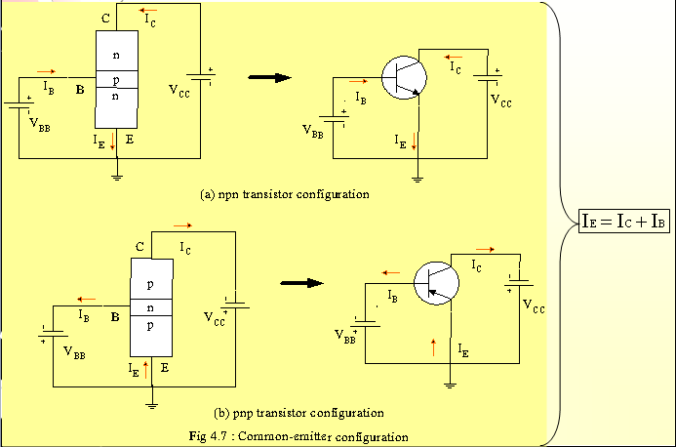
Proper Biasing common-emitter configuration in active region
Notes:
Base acurrent amplification factor
‹#›

Slide 28
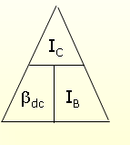
Beta (β) or base current amplification factor
The ratio of collector current (IC) to the base current (IB) is beta (βdc ) which is dc current gain where IC and IB are determined at a particular operating point, Q-point (quiescent point).
In almost all transistors 5% of emitter Current flows as the base current . Therefore β Is generally greater than 20. Normally its value ranges from 20 – 200.

Slide 29
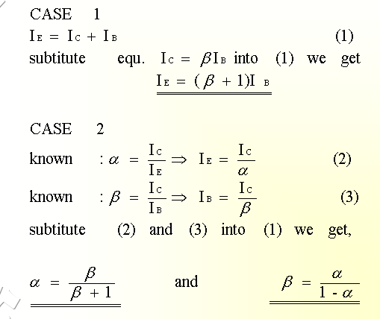
Relationship analysis between α and β
Notes:
B = Ic/Ib
B = Ic/ Ie-Ic
Divide numeratorvand denominator by IE on R.H.S of eqn we get
B= Ic/Ie // Ic/Ie – Ie/Ie
B = alpha //1- alpha
EXPRESSION FOR COLLLECTOR CURRENT .
‹#›

Slide 30
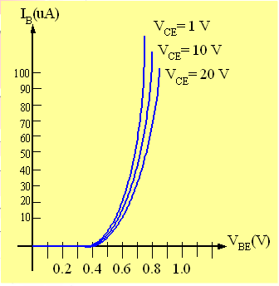
Input characterstics
curve between base current(i/p) I_{B} and base emitter voltage V_{BE} at constant collector emitter voltage V_{CE}
The characteristics resemble that of a forward biased diode curve as BE is F.B.
As compared to CB configuration , Ib increases less rapidly with Vbe. Therefore input resistance is small but higher than that of CB configuration.
Input characteristics for a
common-emitter NPN transistor

Slide 31
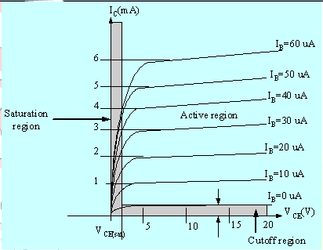
Curve between collector current Ic and collector emitter current V_{CE} at constant base current i_{B}
For small V_{CE} (V_{CE} < V_{CESAT}, I_{C} increase linearly with increasing of V_{CE .} After this collector current is independent of V_{CE} .
V_{CE} > V_{CESAT} I_{C} almost constant. Output resistance is large in CE connection. However small increase in Ic with increase in V_{CE}(slope in fig) . This is because collector depletion layer wider –wider means captures more majority carrier before electron hole combination in base area.
I_{B}(uA) is very small compare to I_{C} (mA). Small increase in I_{B} cause big increase in I_{C} .
I_{C} = β I_{B}
Notes:
First point—bcoz as VCE increase (reverse bias increase )—all base current from base sweeps to collector current and forms o/p current Ic.
I_{B}=0 A 🡪 I_{CEO} occur.
Noticing the value when I_{C}=0A. There is still some value of current flows.
‹#›

Slide 32
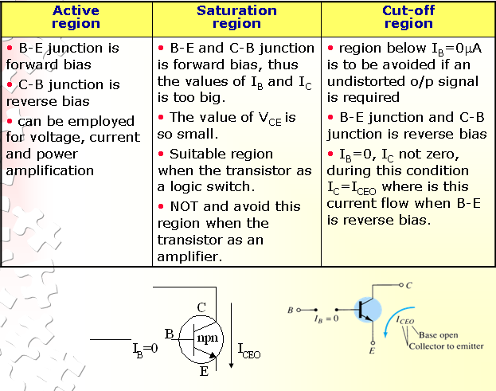

Slide 33
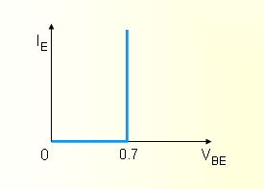
The curves (output characteristics) clearly indicate that a first approximation to the relationship between IE and IC in the active region is given by
I_{C} ≈IE
Once a transistor is in the ‘on’ state, the base-emitter voltage will be assumed to be
V_{BE} = 0.7V
Notes:
Do numericals 8.2 and 8.7 pg 150
‹#›

Slide 34
Transistor act as amplifier how ?
Input resistance low
Output resistance high
Current Ie(input current) nearly equal to Ic(o/p current)
Think on voltage i/p and o/p ??
Notes:
Do numerical example 8.1 –page 147
‹#›

Slide 35
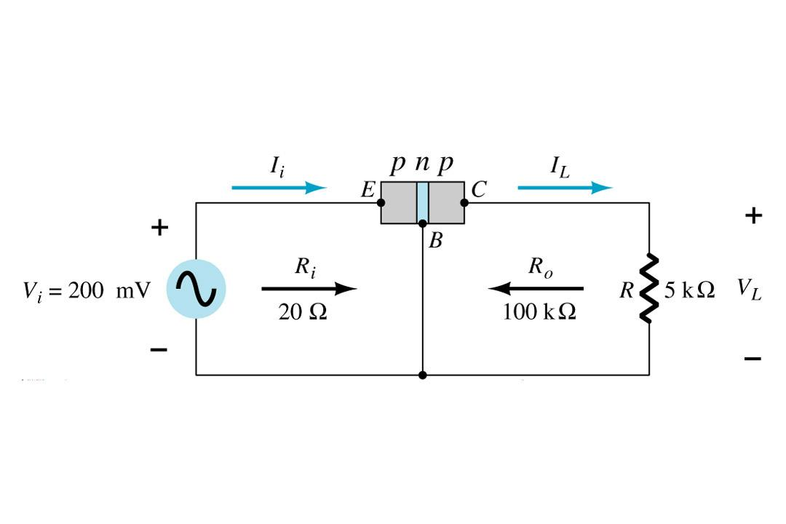
Transistor as an amplifier
Vee
Vcb
Notes:
A transistor raises the strength of a weak signal and act as an amplifier . For this let us consider above circuit diagram.
A weak signal is applied between emitter base junction and output is taken across the load Rc connected in the collector circuit
For faithful amplification , the input should always remain forward biased so a dc voltage Vee is applied in the input circuit in addition to the input signal Vi .This voltage is called bias voltage and its magnitude is such that it always keeps the input circuit forward biased regardless of the polarity of the signal.
As the input circuit has low resistance (due to fb), Small change in input signal voltage causes appreciable change in emitter current Ie.
Collector current Ic(95% of Ie) nearly equal to Ie .
But the collector current Ic flows through high resistance load Rc which produces a large voltage across it.
Thus a weak signal applied in collector circuit appears as amplified form in collector circuit.
Thus transistor acts as amplifier.
Draw mike at input vin and make speaker at Rc --- you get a real life amplifier
Find Ie . Then find ic=ie..then find Vc which is much more than Vin. Thus amplified signal is obtained.
Ie =signal / Rin = 200mV/20 = 10mA
o/p current = Ic = Ie =10 mA
Output voltage = Ic * Rc = 10mA * 5kohm = 50V
Voltage amplification (Av)= 50V/200mV = 250 … Thus acts as ampliffier
‹#›

